Slide 1
Collaboration in Conference Game
Jonathan Ross, Nick Harding, Roman Naumov
HIT Lab students at the University of Canterbury
Christchurch
New Zealand
23.05.2024

Slide 2
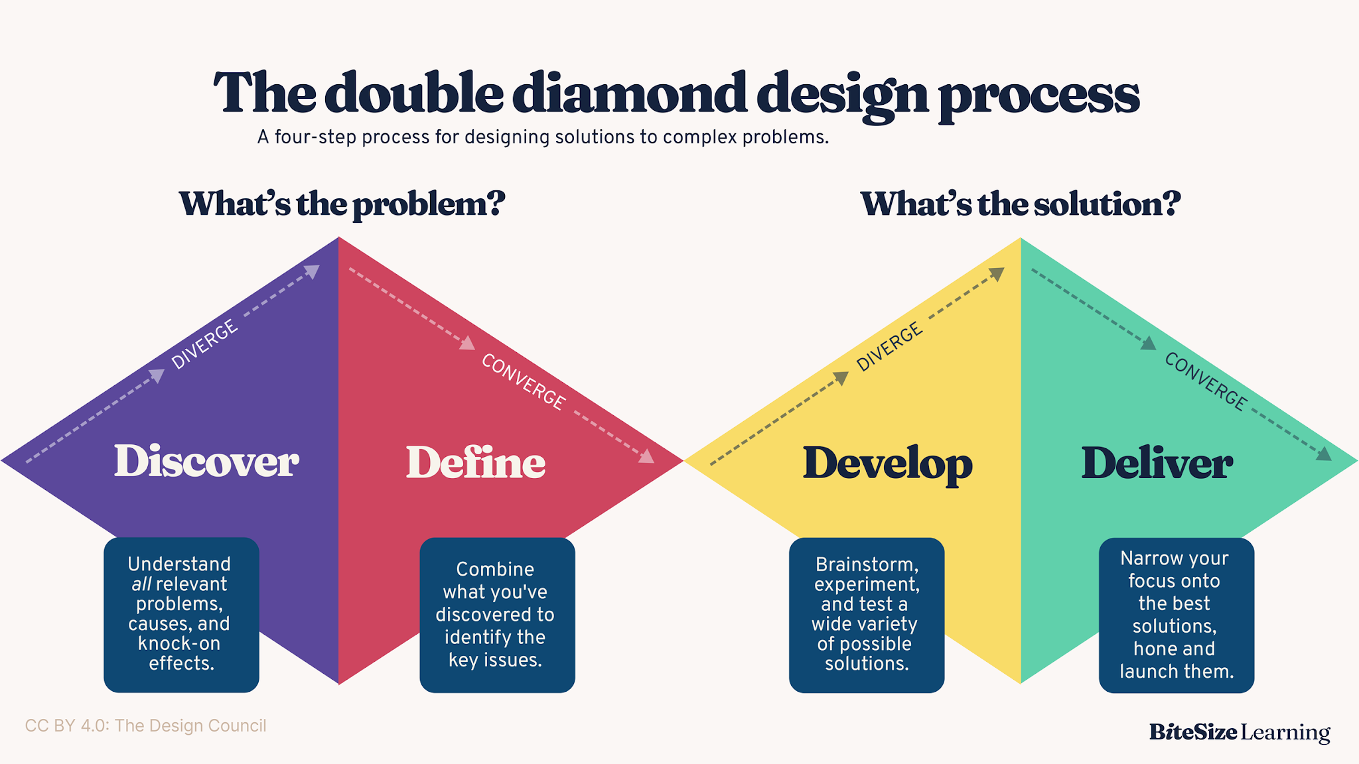
Our Attempted Workflow

Slide 3
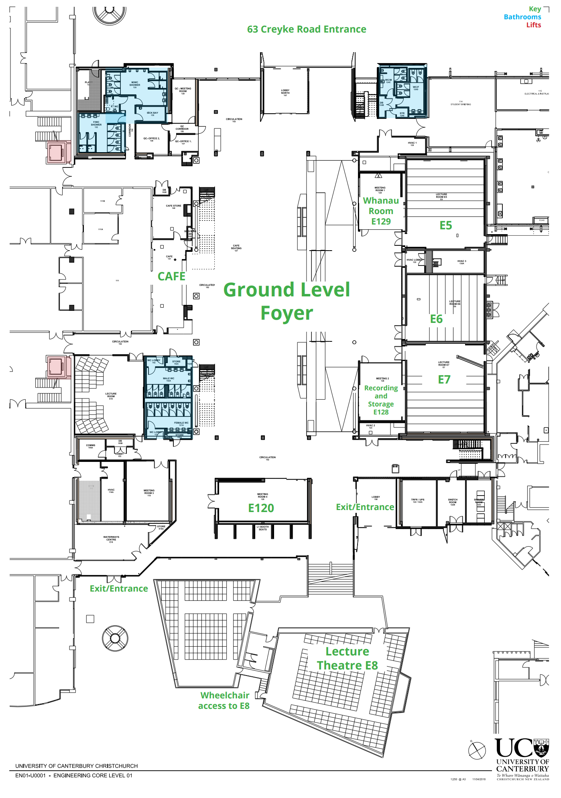
Defining The Environment/problem
STEM Conference
100-200 people
Short time to play games
Lecture area, Workshop Rooms, Poster Sessions, and break tables

Slide 4
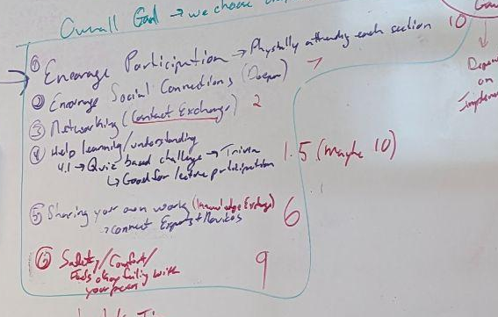
How we decided on the priorities of our game
Goals | Weight
Active Participation | 10/10
Deeper Social Connections | 7/10
Knowledge Exchange and Feedback | 6/10
Safe and Comfortable Environment | 8/10
Networking and Contact Exchange | 2/10
Learning and Understanding | 1.5/10
Primary
Secondary

Slide 5
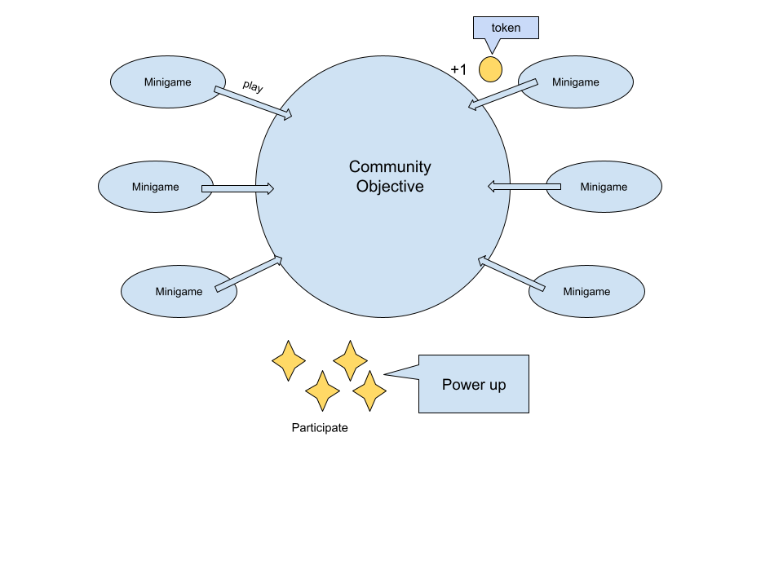
The Game Concept
Notes:
How these games work together to achieve the goals we outlined in the begining

Slide 6
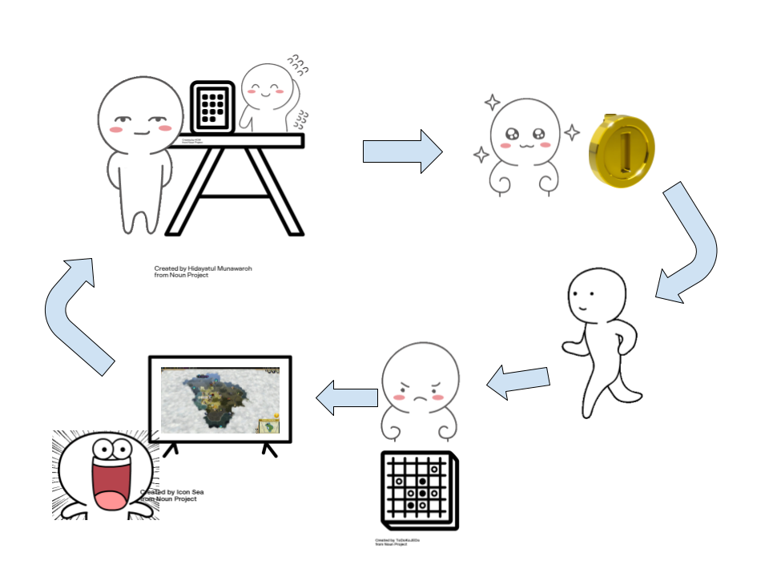
Game Flow
Notes:
User plays mini game
User gets a token that stored virtually
User goes to big table/map/grid with interface device
User selects location, ‘fires’
A small portion of the map is cleared showing collaborative progress of the conference

Slide 7
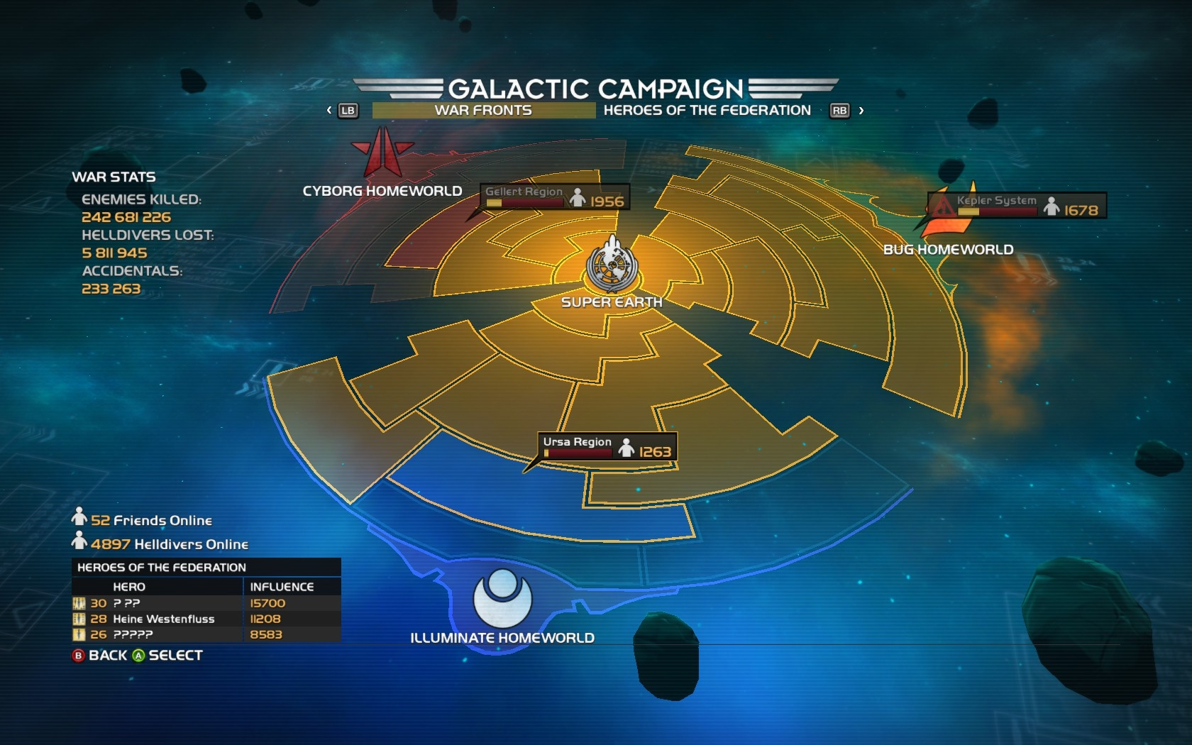

Community Objective
Clear the fog from the map
Local map highlighting points of interest for the attendees
Collaborative effort
Fun story
Gathering place
Motivation for returning to social games
Helldivers 2
Curiosity: What’s inside the Cube
https://www.wired.com/2012/11/curiosity/
Notes:
How would this work
The overall map
Fog disappearing
Points of interest with facts
Collaborative effort to clear the fog
How they get tokens to clear
Playing minigames
Boost from participation activities

Slide 8
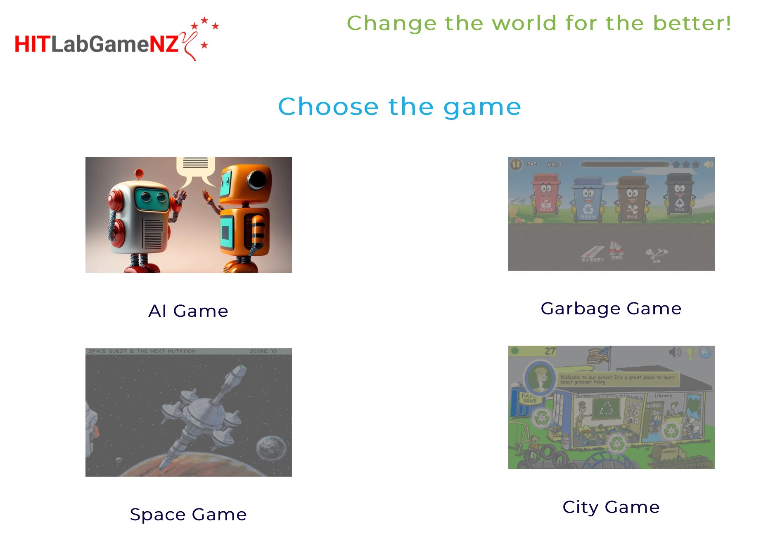
Mini Games
Icebreaker style games designed to build comfort and connection between participants
Short games as to not get in the way of regular participation
Scalable for number of attendees
Get tokens for participation
Priority is connection between players

Slide 9
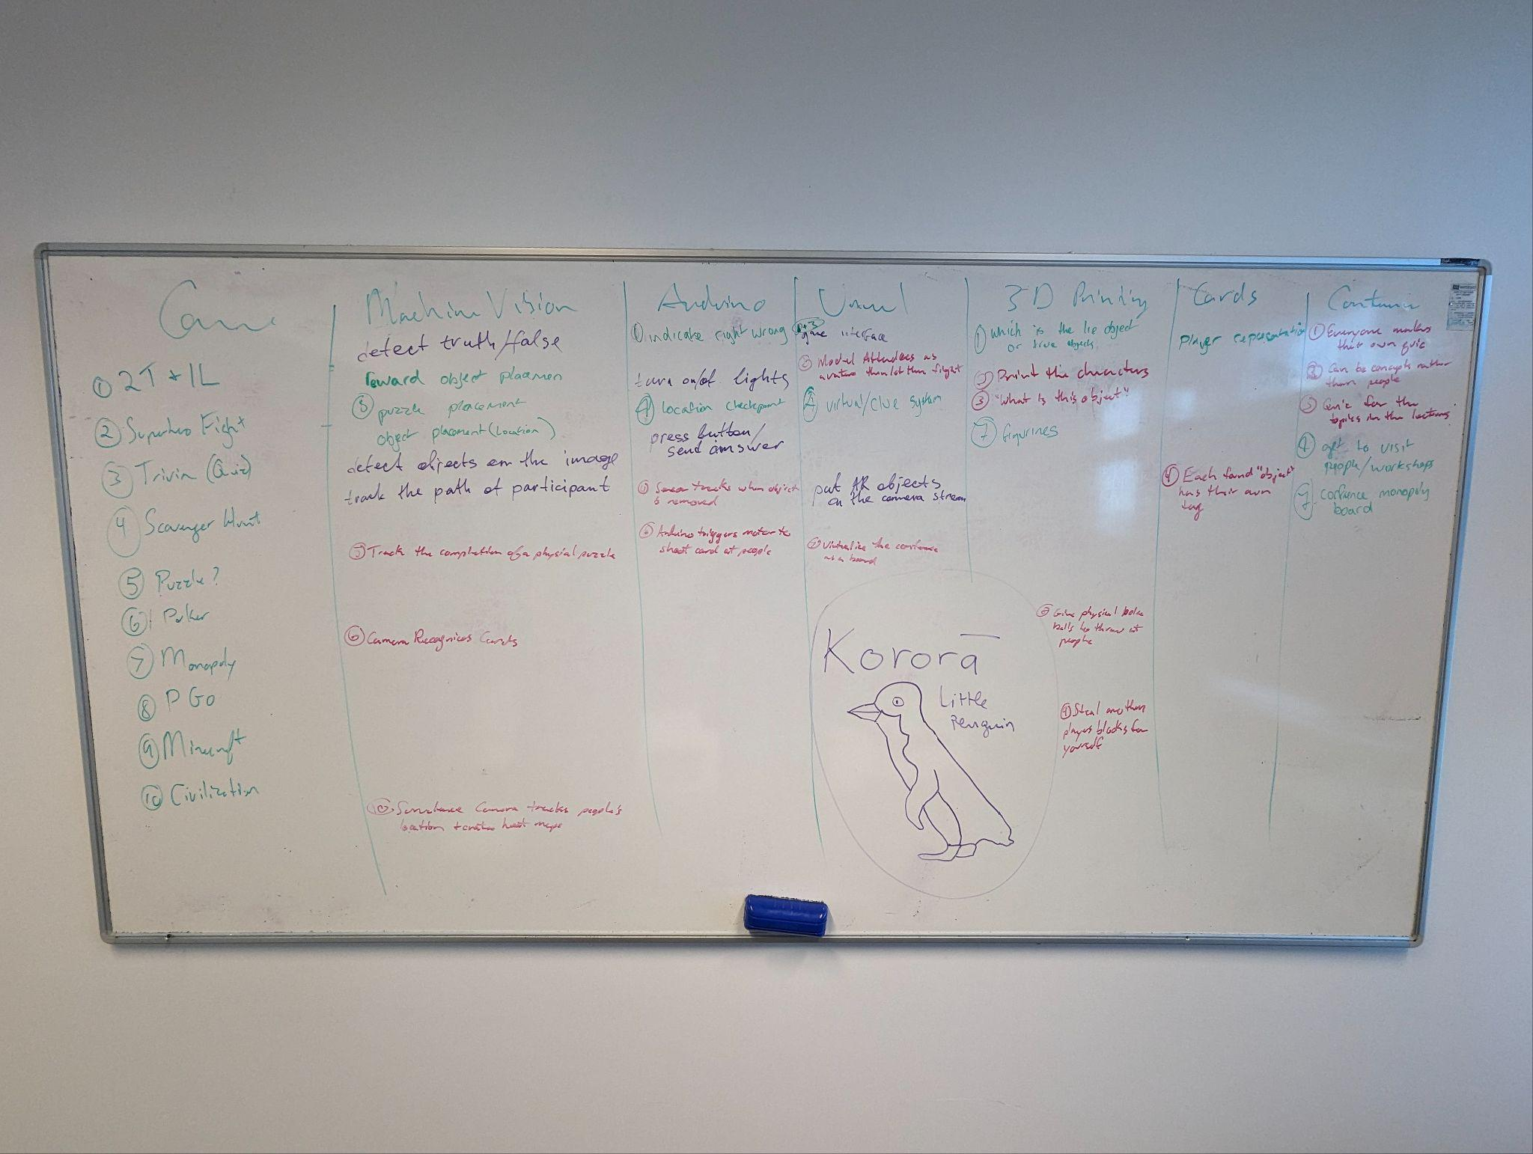
Brainstorming
Used AI for started ideas
Independently ideated
Combined with our experience
Expanded using a technological association chart

Slide 10
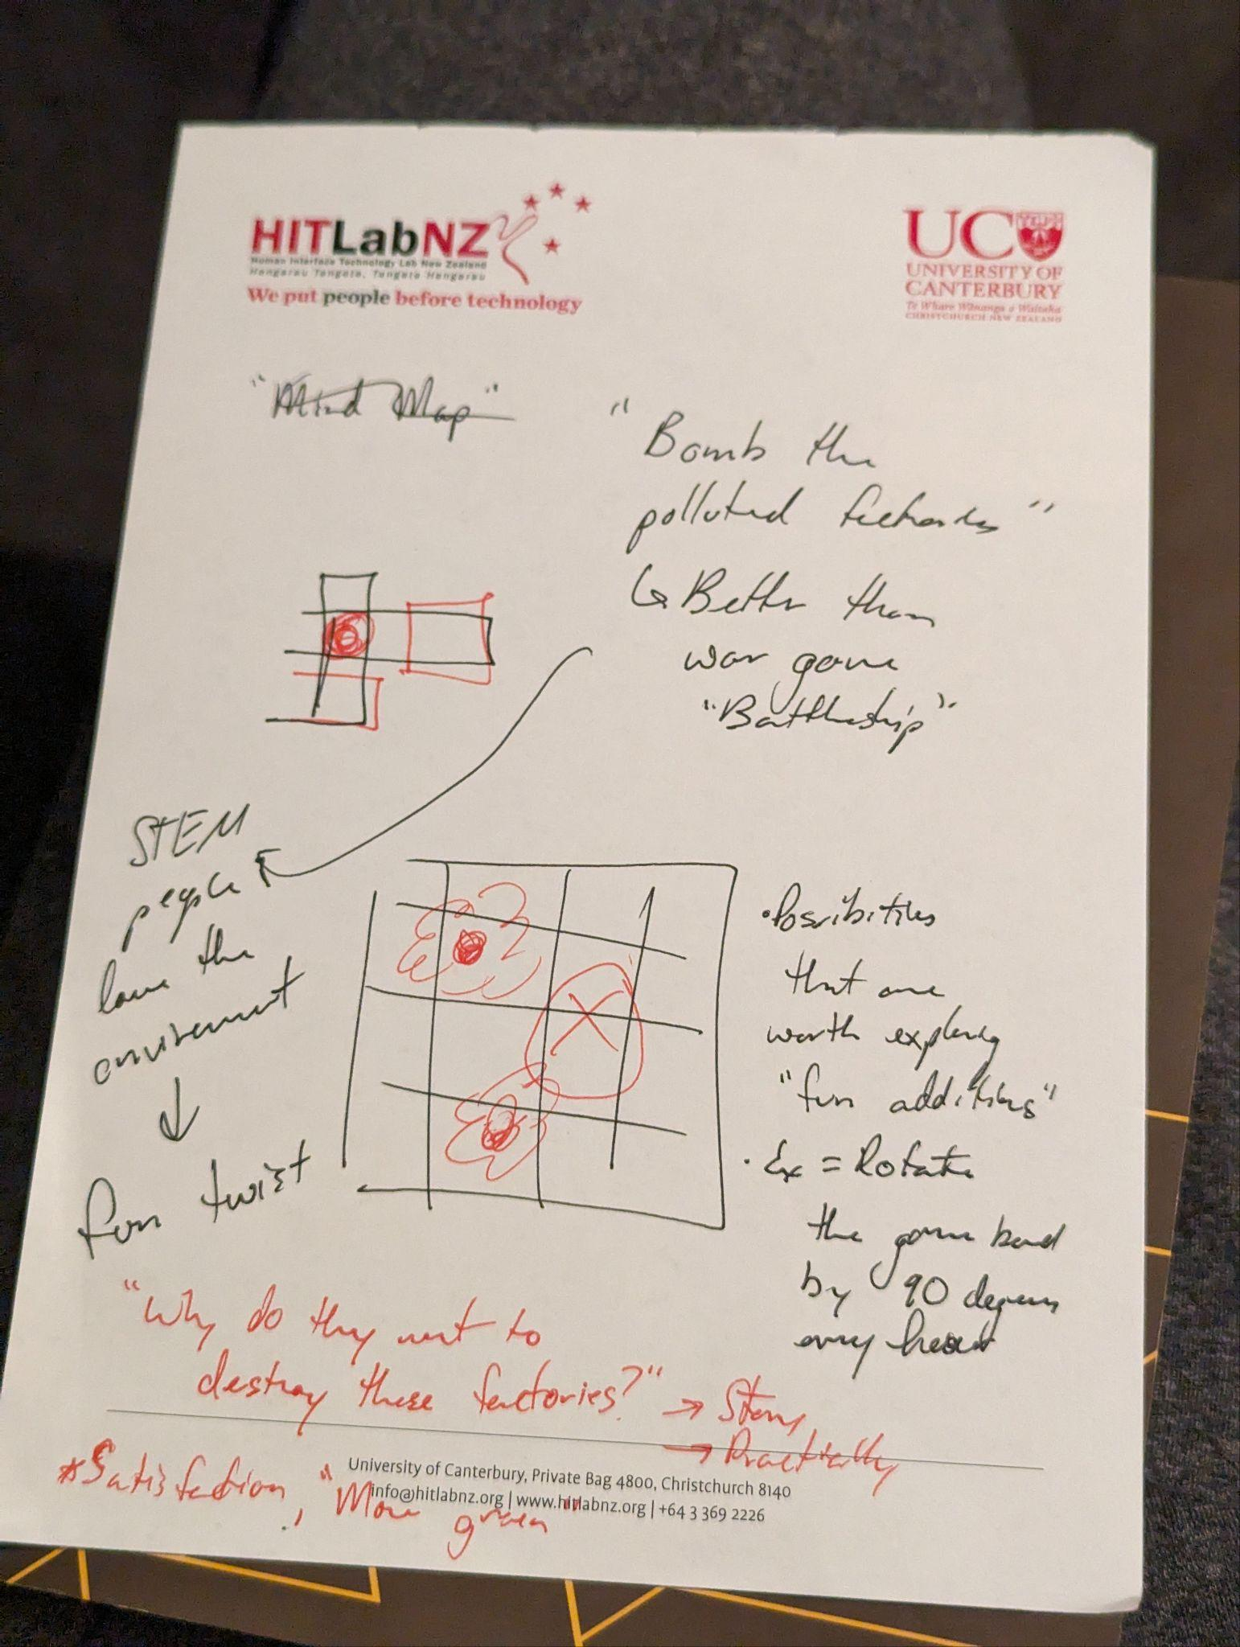
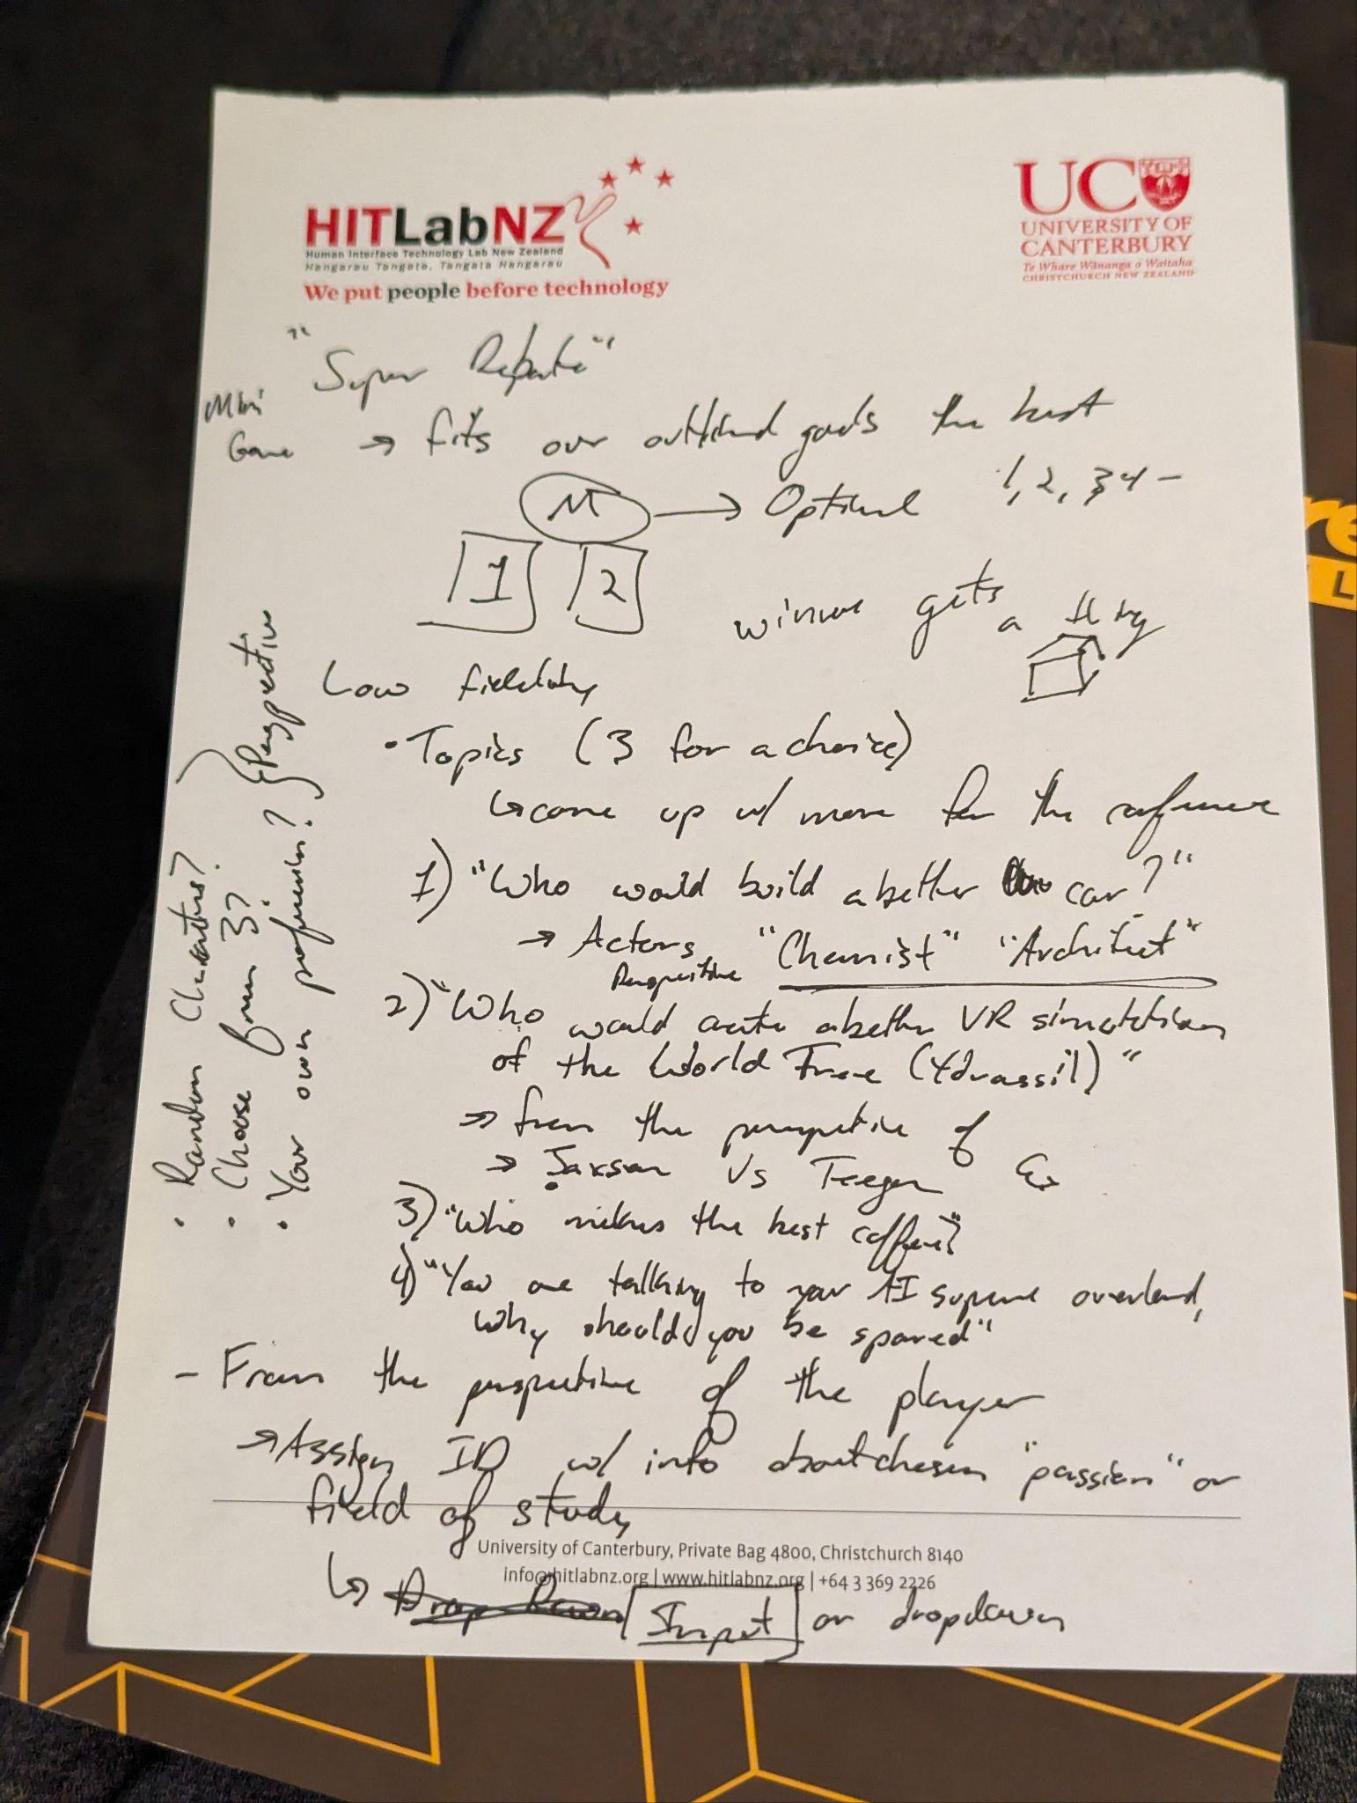
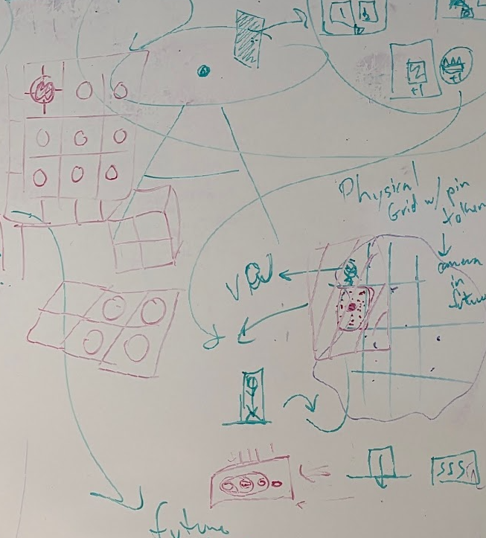
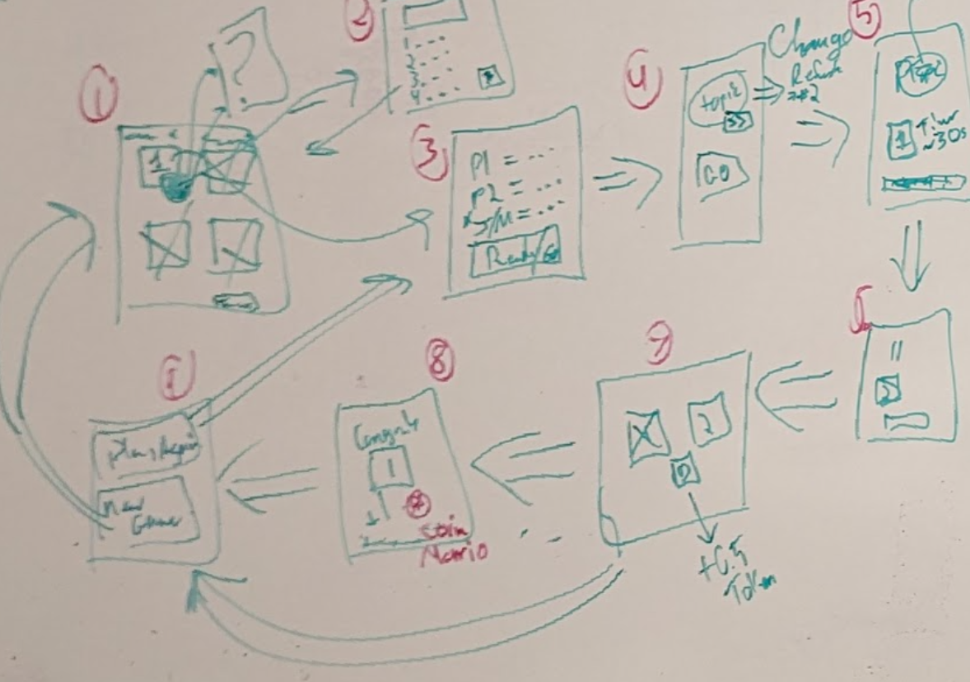
Low Fidelity Prototype
Primarily used with the mini games
Discussion in class with paper sketches
Received feedback on debate structure
Played with friends
Sketched UI to understand function in community game
Notes:
What did we have? Why did we have that? What did we learn? How did we apply it?
Discussion/Demo in class. Never got to the big game prototype
Roman playing games/sketch for mini game (after the low fidelity class)
Sketch of the big game (later)

Slide 11
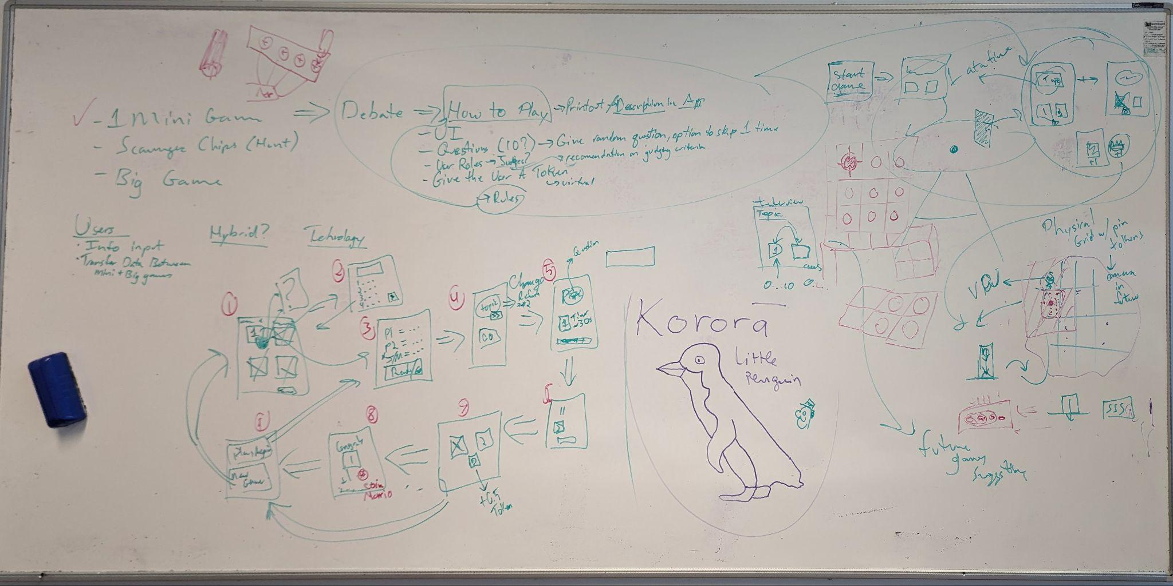
High Fidelity Prototype
MoSCoW prioritization
Looked at what is achievable in short time
Divide and Conquer
Horizontal Prototype
Show flow of minigame to big game
Notes:
What are the important parts to show in the prototype
Moscow analysis
Decided one ‘playthrough’ of the game is essential. Horizontal prototype
What we can achieve using our own knowledge
How we can make it/ “divide and conquer”
What’s the point of this prototype

Slide 12
Applicable technologies
Prototype development stack
Requirements engineering, MoSCoW, Brainstorming, Agile
Low-Fidelity and High-Fidelity prototyping
Technology stack
Full-Stack web-development using AWS (for Mini Games)
Arduino (for physical elements in the Big Game)
Unreal Engine (for digital elements in the Big Game)

Slide 13
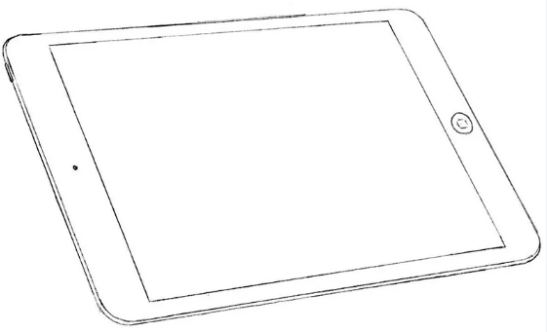
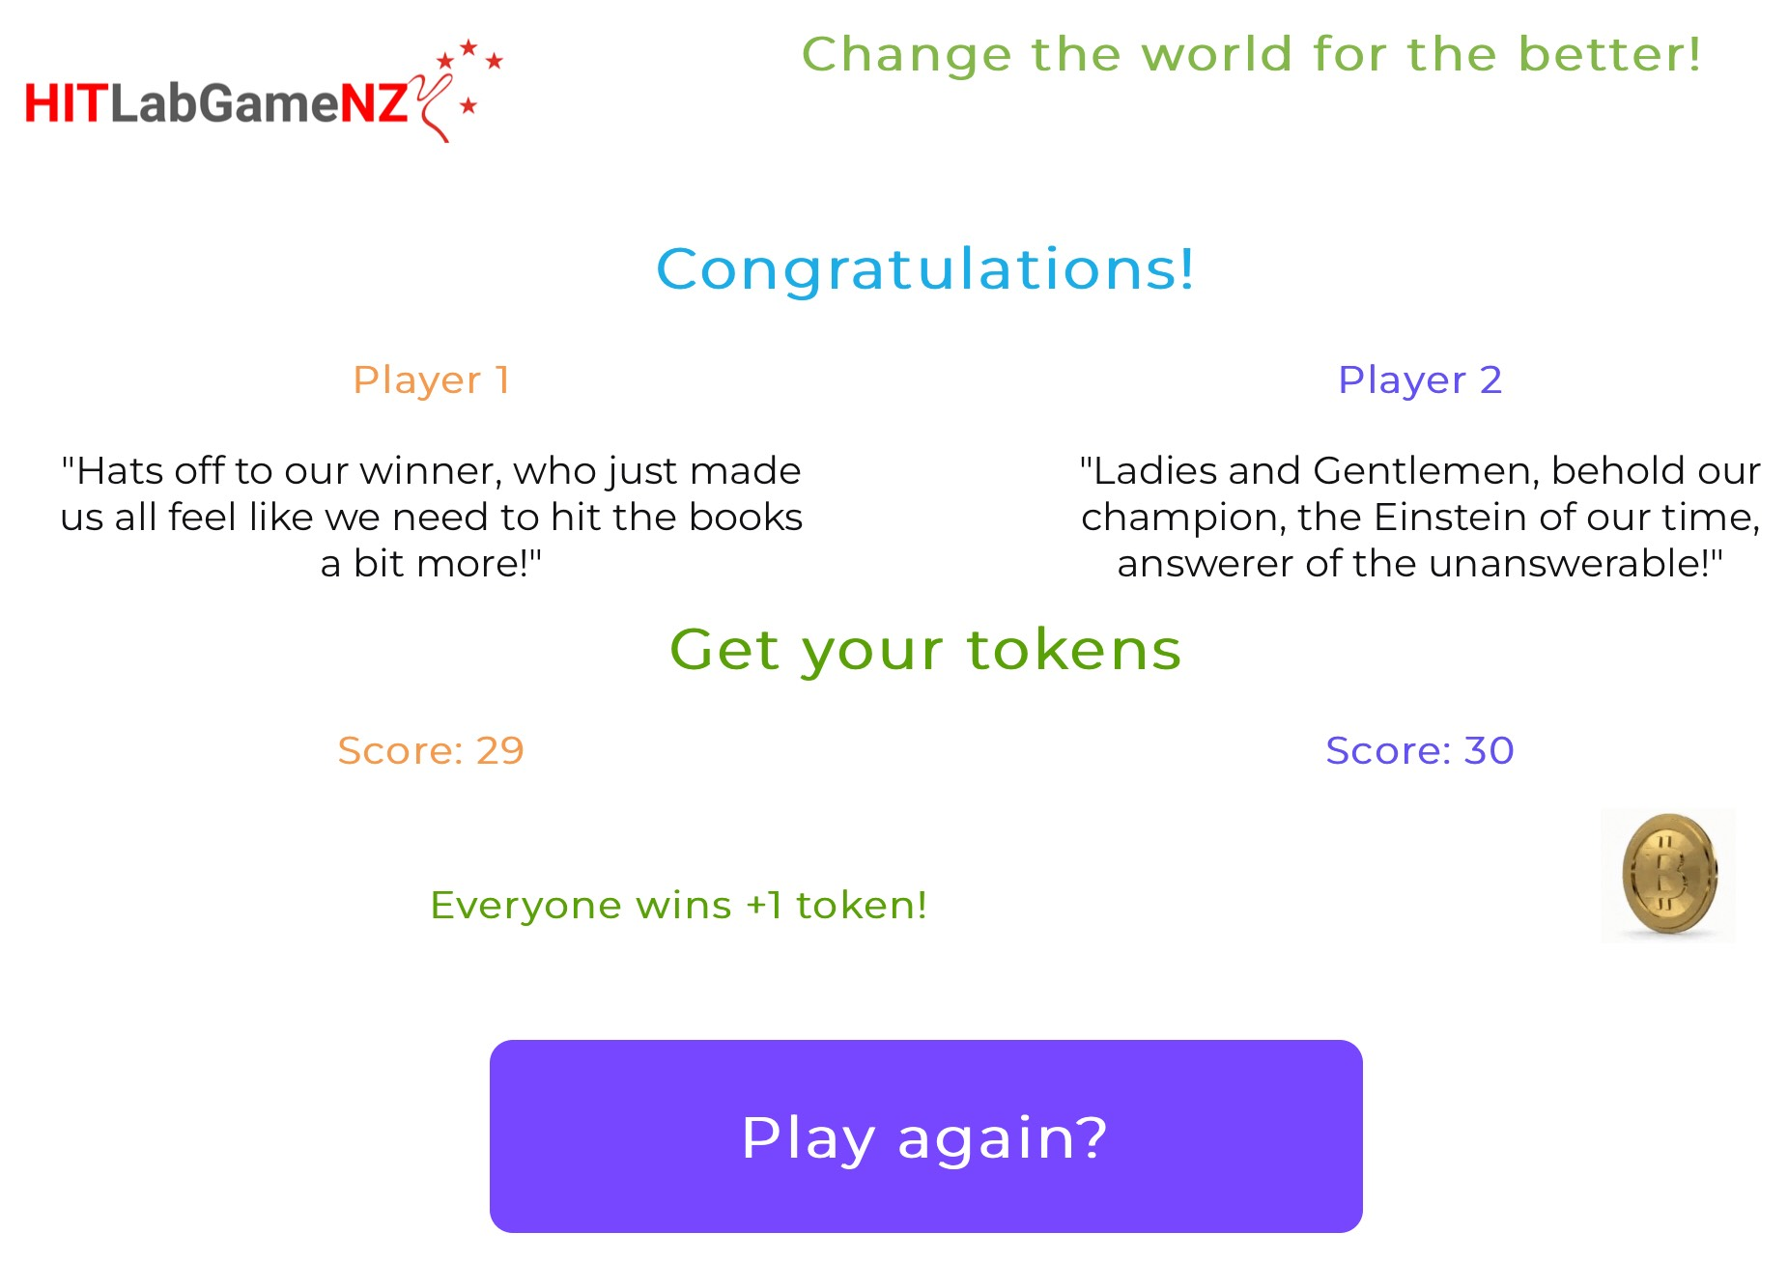
Mini game prototype
Web Server
Technology stack
Amazon Web Services (AWS)
Web server (Python, Flask, Gunicorn, Nginx)
Notes:
Why we are using the Web APP? Why we choose these tecnologies?

Slide 14
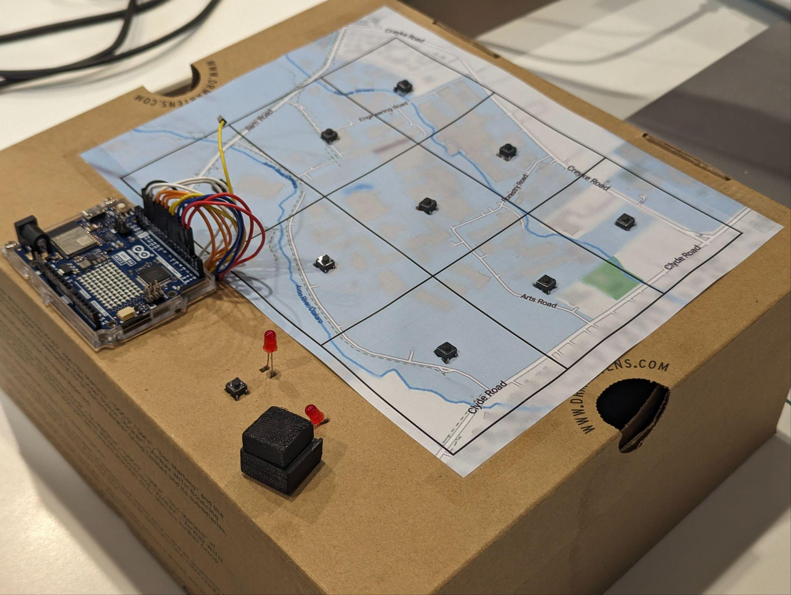
Big game prototype
Map and Arduino
Technology Stack
Arduino (for physical elements in the Big Game)
Python, C++ and JSON
Unreal Engine (for digital elements in the Big Game)
Blueprints and JSON
Blender (for rapid 3D visual prototype)
Python and RenderDoc

Slide 15
Future work/Implementation Plan
Ideas that are not implemented in the prototype
More mini games that are asses
Free map of area/bigger area
Interface that is better than arduino
Save user data to unique identifiers (amiibo)

Slide 16
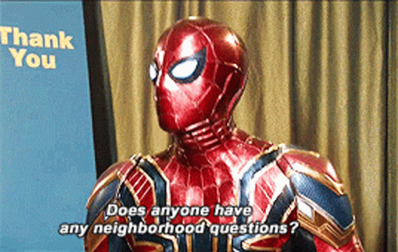
Thank you!
Any Questions?

